Slide 1
CS 106A, Lecture 26 A Gentle Intro. to Machine Learning
suggested reading:
none!

Slide 2
Plan for today
What is machine learning?
Why is it useful?
Supervised Learning
Demo: k-Nearest-Neighbor
What else can machine learning do?

Slide 3
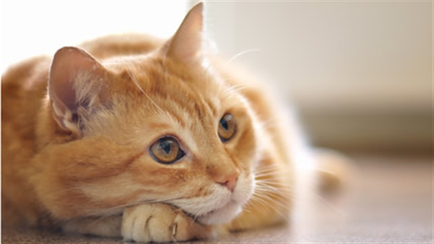
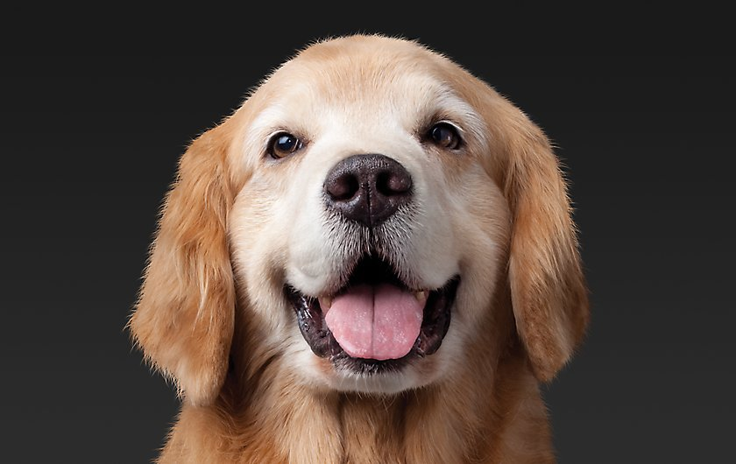
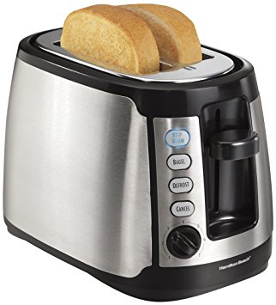
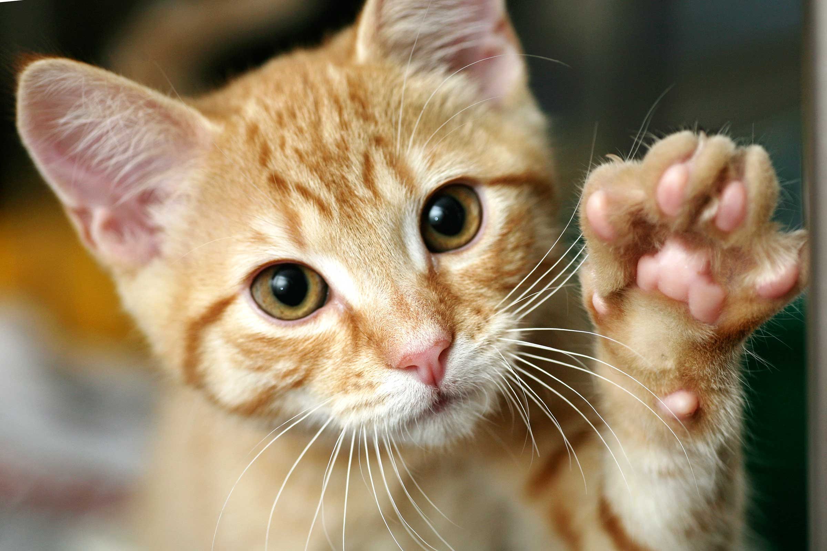
Animal Classification Ex.
We have a picture and we want to know if it’s a cat or not.
true
false
true
false

Slide 4
Animal Classification Ex.
Here’s one way you might code this…
private void isCat(GImage animal) {
int[][] pixels = animal.getPixelArray();
if (containsTwoEyes(pixels)){
if (hasWhiskers(pixels)){
if (hasPointyEars(pixels)){
return true;
}
}
}
return false;
}

Slide 5
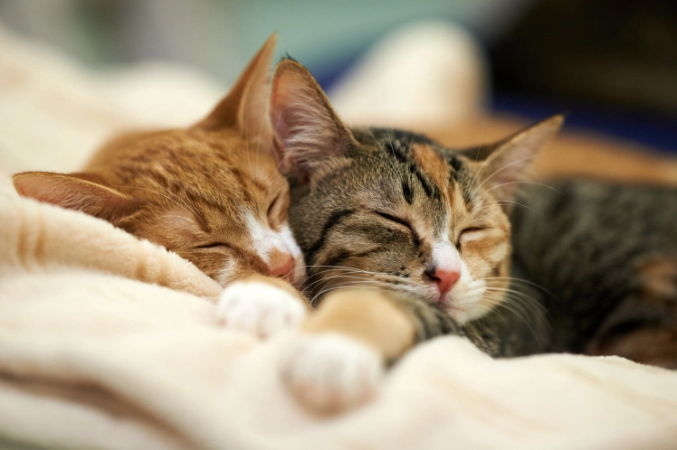

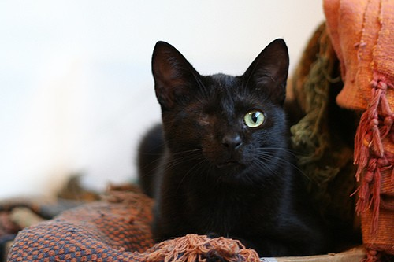
Some tricky cases

Slide 6
Pros/Cons
Pros
Matches our human intuition about what a cat is
Easy to understand the code
Cons
Requires us to explicitly enumerate every feature that’s important, and know how important it is
Need to write code to detect eyes, and whiskers, and the pointiness of ears
Will never improve… cannot learn from its mistakes

Slide 7
What is Machine Learning?
“The field of study that gives computers the ability to learn without being explicitly programmed” - Arthur Samuel, 1959
How can a computer do this?
Data.
Notes:
“How did you learn what a cat was?”

Slide 8
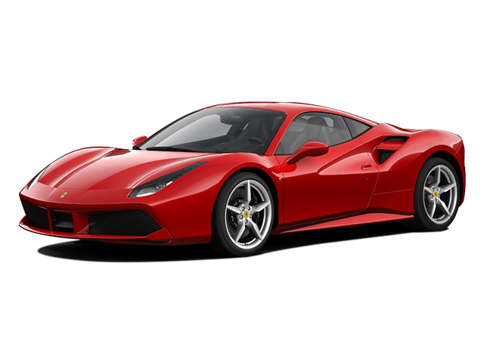
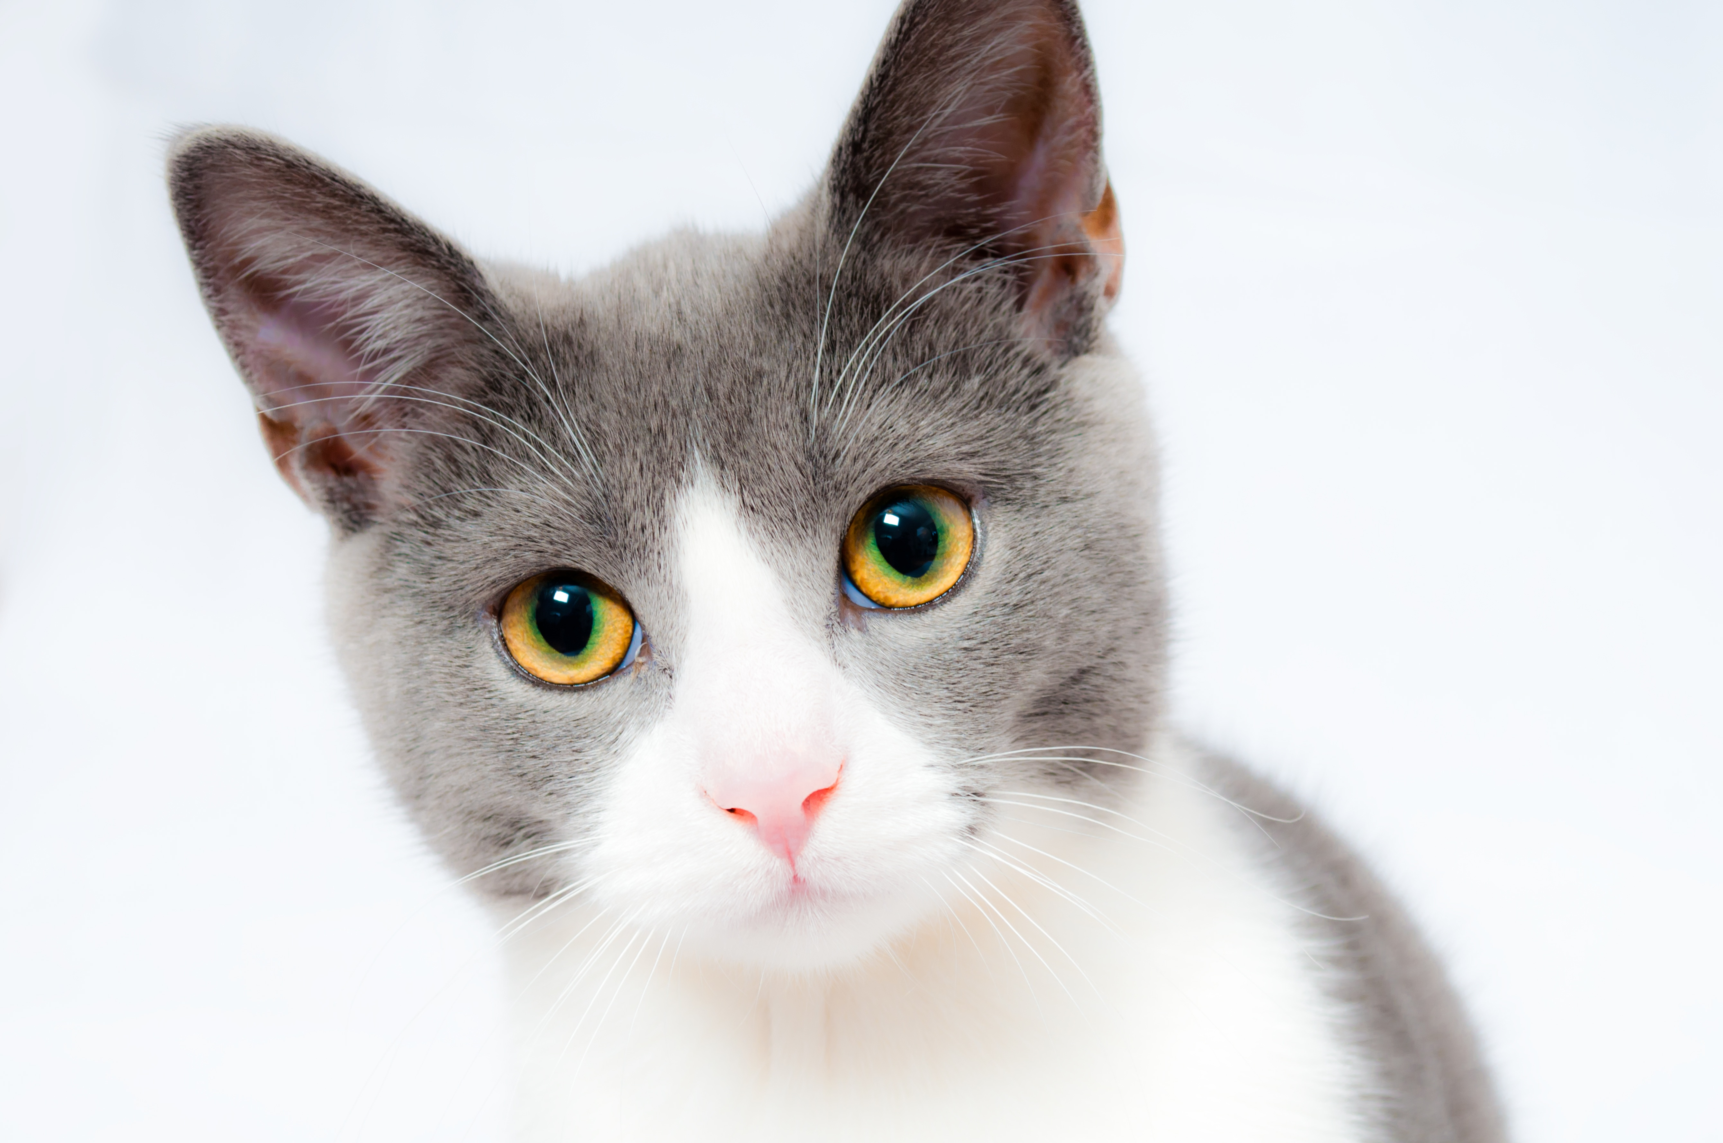
Animal Classif.: Take 2
Here’s a sketch of how we can approach this problem in the machine learning paradigm:
Input to the algorithm: MANY cats and MANY not-cats
For each image provided to the algorithm:
Predict whether image is cat or not-cat
If correct, great, proceed to the next image
If incorrect, update the algorithm to do better next time
…
cat
cat
not cat

Slide 9
Pros/Cons
Pros
Doesn’t require us to explicitly tell the algorithm what’s important to distinguish between cats and not-cats
Not specific to the cat problem: we could show it images of anything and train it to learn the difference
Gets better the more data we give it
Cons
Sometimes hard to know why the algorithm makes the predictions it does
Requires us to specify an update mechanism: how is the algorithm supposed to improve itself?
Might require a lot of data to perform well

Slide 10
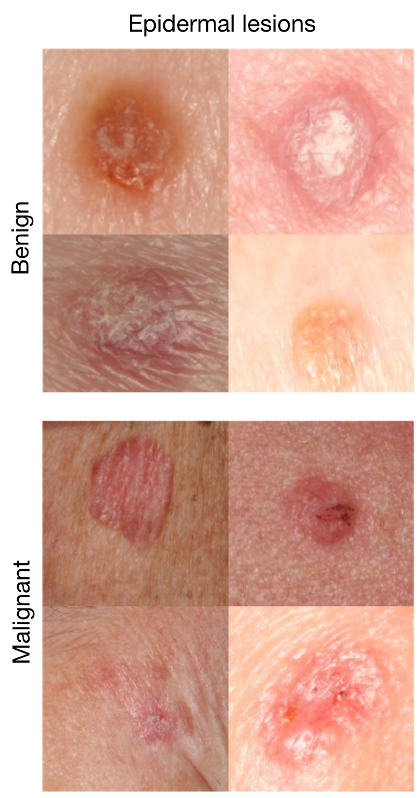
Where is this useful?
Skin cancer classification
Is a given lesion benign or malignant?
A machine learning algorithm has been shown to perform as well as dermatologists.
There are other tasks where machine learning algorithms perform better than skilled humans.
Esteva et al., Nature 2017.

Slide 11
Digit Classification
Task:
Given a picture of a handwritten digit from 0-9, predict which integer it is

Slide 12
Digit Classification
Task:
Given a picture of a handwritten digit from 0-9, predict which integer it is
→ 3
→ 4
“label”
→ 2
→ 9

Slide 13
Train Data / Test Data
The algorithm gets training data that it can use to make predictions.
We use test data to evaluate how well it performs.

Slide 14
k-Nearest Neighbors
Idea: when given a test image, look through all the training images to find the “closest” image.
Under the assumption that “close” images share the same label, return the label of that closest training image.
What does it mean for an image to be “close” to another image?

Slide 15
k-Nearest Neighbors
Idea: when given a test image, look through all the training images to find the k “closest” images.
Under the assumption that “close” images share the same label, return the most common label of the k closest images.

Slide 16
k-Nearest Neighbors
Given a test image T and a set of training images S:
C = k closest images to T
For each training image I in S:
distance = distance(I, T)
if distance < distance between I and the images in C:
add I to C
return most common label in C

Slide 17
k-Nearest Neighbors
TRAIN
TEST
K=3

Slide 18
k-Nearest Neighbors
TRAIN
TEST
K=3

Slide 19
k-Nearest Neighbors
Given a test image T and a set of training images S:
C = k closest images to T
For each training image I in S:
distance = distance(I, T)
if distance < distance between I and the images in C:
add I to C
return most common label in C

Slide 20
k-Nearest Neighbors demo!
nothing to see here, carry on ☺

Slide 21
What else can ML do?
Supervised Learning
Classification, like the cat or skin cancer or digits examples
Regression

Slide 22
Regression Example
House price prediction
Training Data
Test Time
Square Footage | House Price
1,000 | 150,000
1,256 | 175,000
5,897 | 2,000,000
4,300 | 1,300,000
2,400 | 750,000
2,600 | 690,000
3,000 | 1,000,000
“My house has 1,800 square feet. How much should I expect it to sell for?”

Slide 23
What else can ML do?
Supervised Learning
Classification
Regression
Unsupervised Learning
Finding structure in unlabeled data

Slide 24
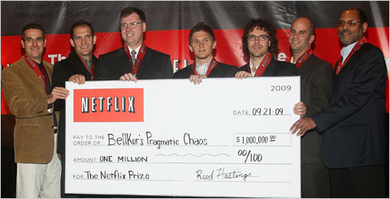
Netflix Prize Example
Netflix Prize

Slide 25
What else can ML do?
Supervised Learning
Classification
Regression
Unsupervised Learning
Reinforcement Learning

Slide 26
What remains really hard?
Human-like dialog
Common-sense reasoning about the world
Strong generalization
Learning to learn
… and much else ☺

